Slide 1
IT Sector Growth and Electricity Demand in Buildings
NEMS Conference
March 12, 2002

Slide 2
Historical Electricity Growth
Electricity has been the fastest growing energy source in buildings, over almost any decade-long span going back to 1960.
Key factors:
  penetration of air conditioning, electric heat pumps and electric appliances
  growth in south and west
  home and office electronics
    IT-related equipment is a important contributor
    non-traditional uses and computer and related equipment and other office equipment are the fastest growing components in AEO 2002

Slide 3
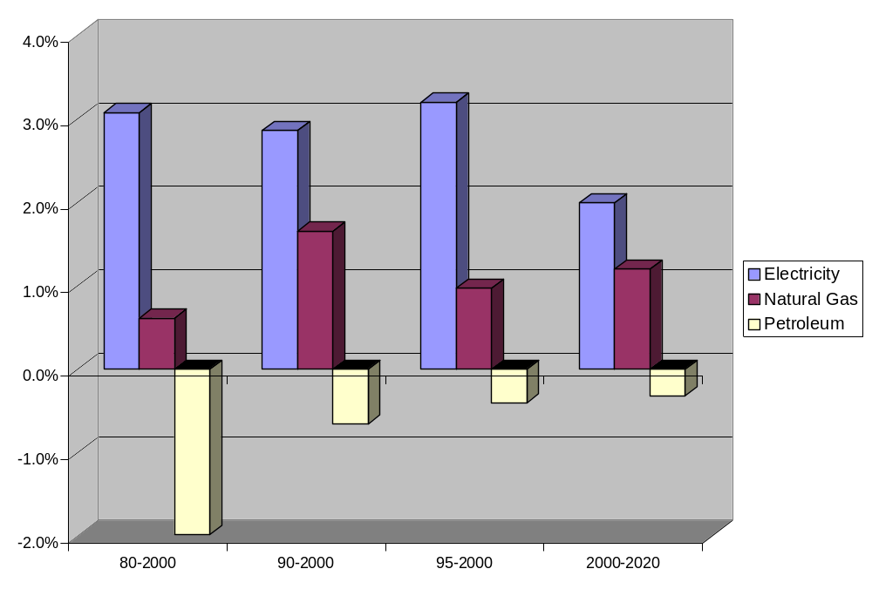
Building Sector Major Energy Sources CAGR Various Intervals

Slide 4
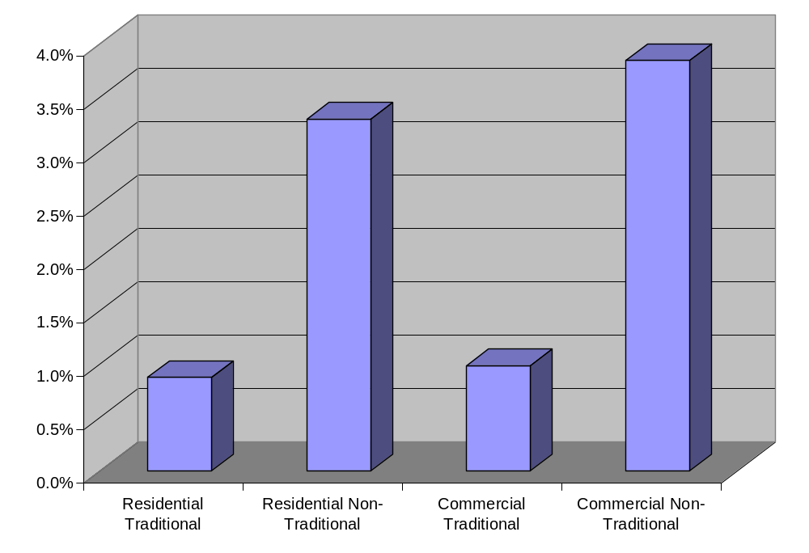
Building Sector Electricity Growth
CAGR 2000-2020

Slide 5
Assumed Computing Environment for AEO2002
Desktop Computing Will Continue to Grow
Local PC Hardware Will Continue to Provide Computing, Storage and Multi-Media
No Radical Changes from Today’s Structure
Internet Will Continue to Grow in Content and Bandwidth

Slide 6
Key Issues for AEO Projections
PCs and Related Equipment
  Penetration Limits (per HH, per Employee)
  Energy Star Enabling Rates
  PC and Related Technology
    Energy Consumption of PC (CPU, Storage Media)
    Monitor Display Area
    Monitor Technology Shift to LCD
    Evolution of Related Equipment (Video, Audio, Printing)

Slide 7
Key Issues for AEO Projections
(continued)
Networks and Related Equipment
  Growth in Internet
    Number of Users and Usage “Intensity’
    Number of Sites
    Bandwidth
  Growth in Data Center Energy Consumption
    Growth in Data Centers
    Energy Consumption of Servers and Routers
    Data Center Design Improvements

Slide 8
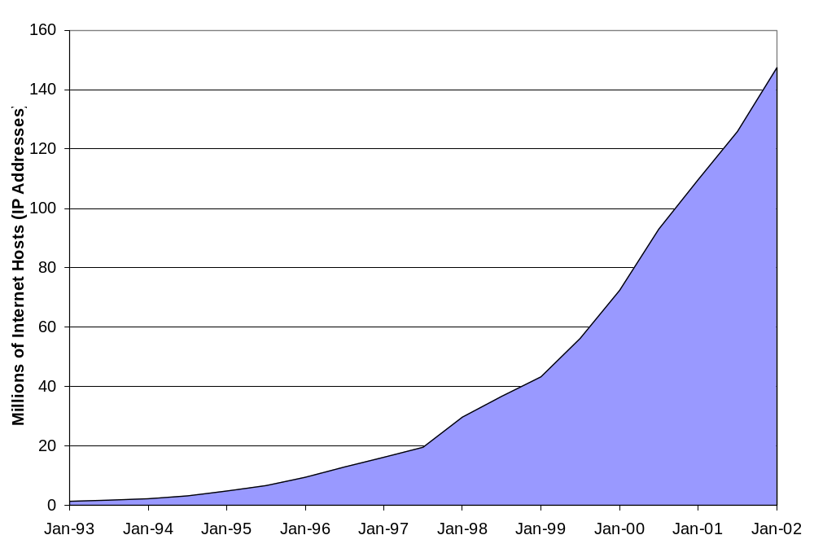
Internet Domain Survey
Source: Internet Software Consortium (http://www.isc.org/)

Slide 9
Presentations
IT-Related Demand in the AEO 2002
  Erin Boedecker, Energy Information Administration
Latest Measured Data on Data Center Power Use in the U.S.
  Jonathan Koomey, Ph.D., Lawrence Berkeley National Laboratory
Energy Consumption by Commercial Office and Telecommunications Equipment
  Kurt Roth, Ph.D., Arthur D Little, Inc.

